Slide 1


RESTAURANTS AND CONSUMERS
DATA MANAGEMENT presented by
- Sri Charan Chintha
- K.Joshna Praharsha

Slide 2
TABLE OF CONTENT
Introduction
Problem Statement
Tables
ER Diagram
Queries

Slide 3
INTRODUCTION
Restaurants and consumer data typically involve tracking information about customers, customer preferences, restaurants , restaurant cuisines ,ratings .
This project involve about the restaurant and consumer relationship with usage of some entities.
SQL as it provides a structured way to handle large datasets, ensuring efficient data organization, querying, and reporting for decision-making.
Using SQL for a restaurant dataset offers powerful ways to manage, analyze, and derive insights from data related to customers, orders, menu items, and operations
It offers hands-on experience in understanding data relationships and operational workflows.
A relational database can store this data in tables, with SQL queries used to retrieve, manipulate, and analyze it.
Goal of improving decision-making and operational efficiency through data analysis in a restaurant dataset using SQL.

Slide 4
PROBLEM STATEMENT
In the fast-paced environment of a restaurant, managing and analyzing large volumes of
data related to menu items, customers, orders, and inventory is critical for efficient operations
and informed decision-making. This project aims to design and implement a relational
database system that captures essential restaurant activities and enables users to retrieve and
analyze data through SQL. The system will support complex queries to uncover key business
insights, such as top-selling menu items, high-value customers, and revenue patterns,
Restaurants that have franchises in different cities.
Restaurants with high overall ratings. Consumers who prefer American cuisine and have medium
budget. Restaurants that serve wine & beer at medium price. And many more insights while
reinforcing practical SQL skills including joins, where clause ,order of execution ,View , store
procedure.

Slide 5
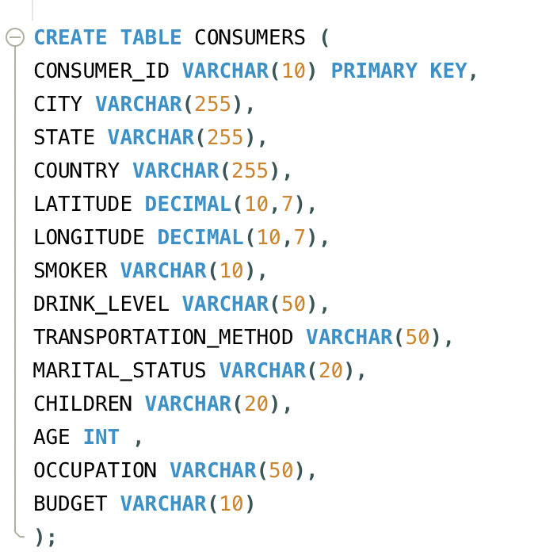
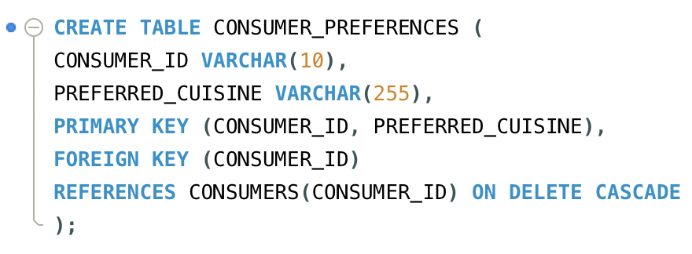
TABLES
CONSUMERS TABLE
CONSUMER PREFERENCE TABLE

Slide 6
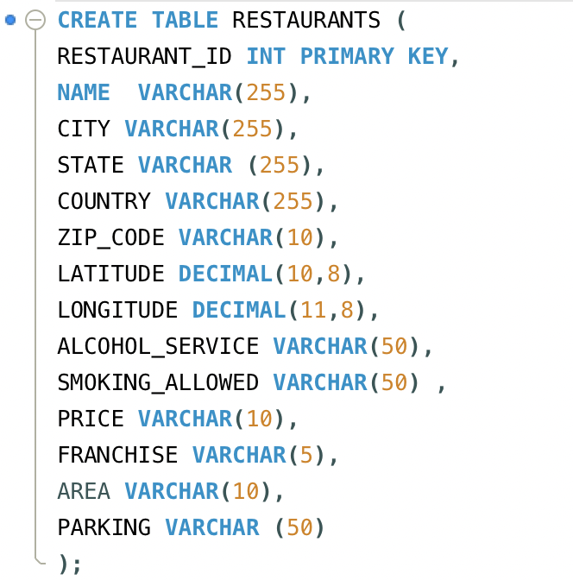
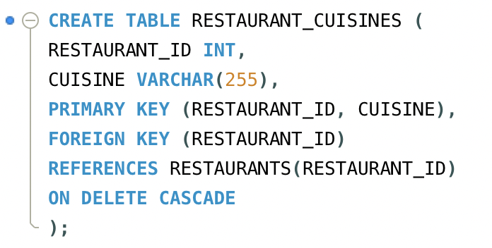
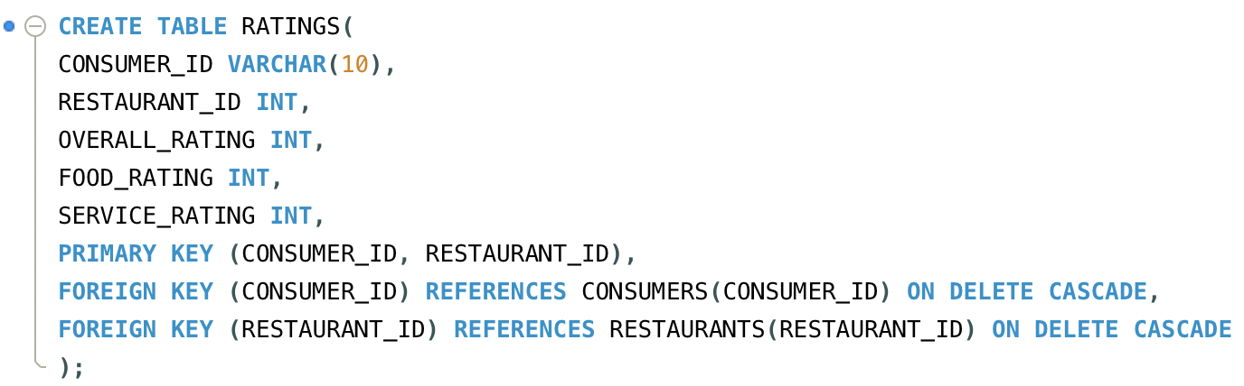
RESTAURANTS TABLE
RESTAURANT CUISINES TABLE
RATINGS TABLE

Slide 7
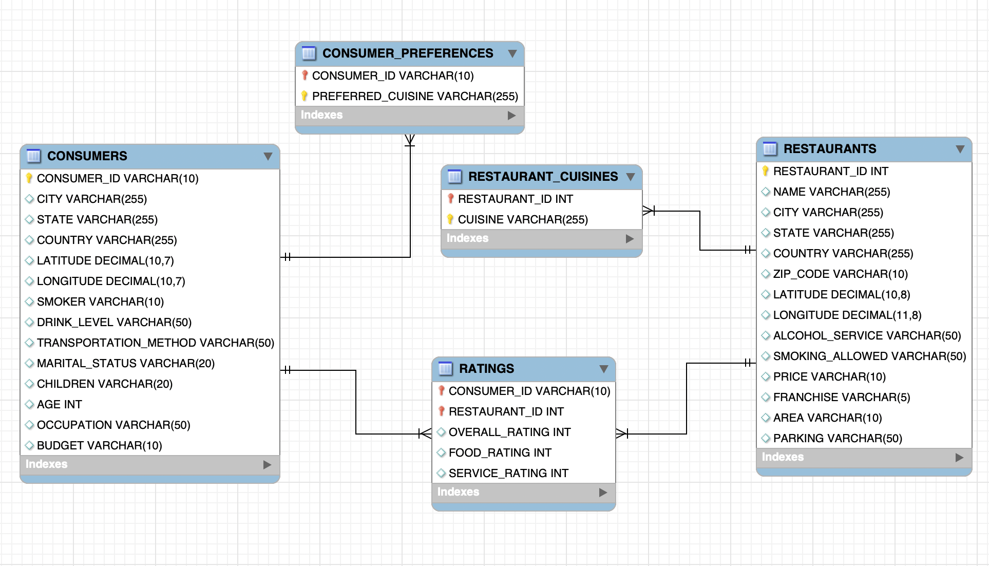
ER DIAGRAM

Slide 8


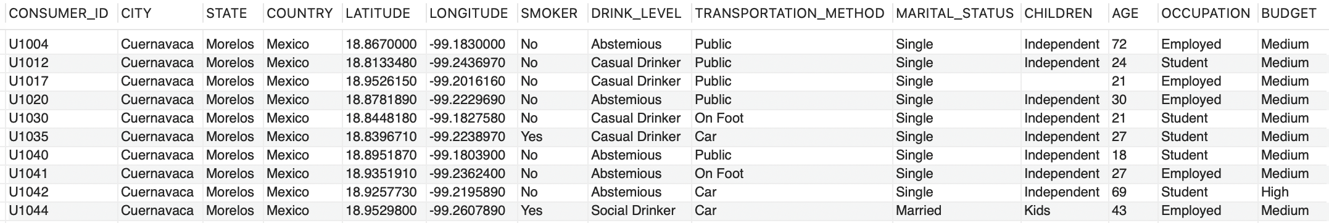
QUERIES
1.List all details of consumers who live in the city of 'Cuernavaca'.

Slide 9

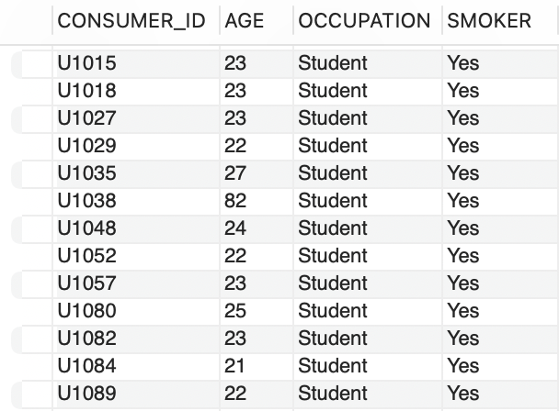
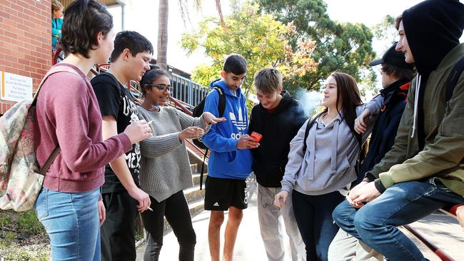
2.Find the Consumer ID, Age, and Occupation of all consumers who are 'Students' AND are 'Smokers'.

Slide 10
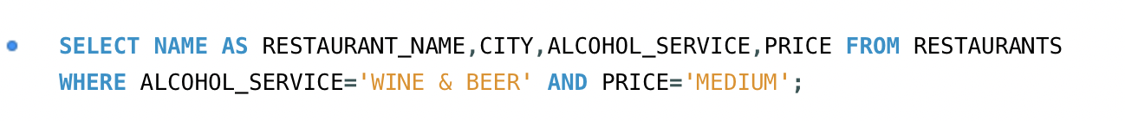
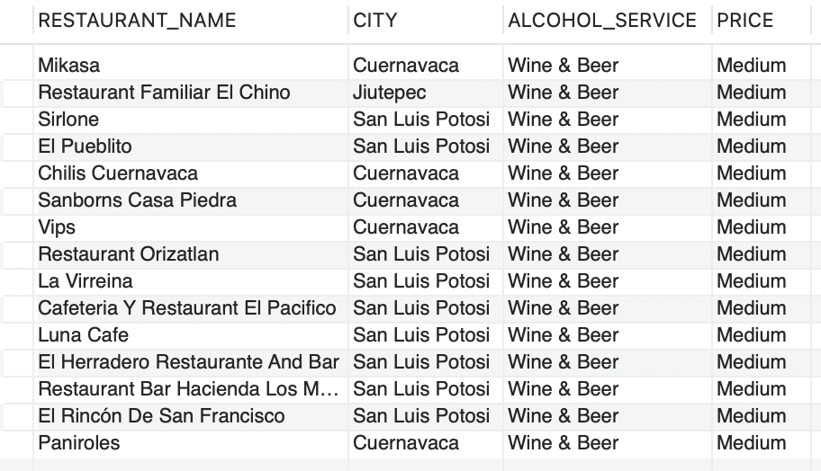

3.List the Name, City, Alcohol Service, and Price of all restaurants that serve 'Wine & Beer' and have a 'Medium' price level.

Slide 11
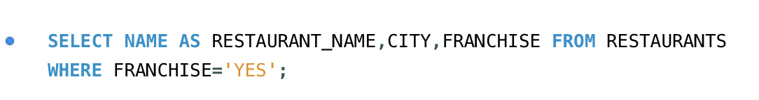
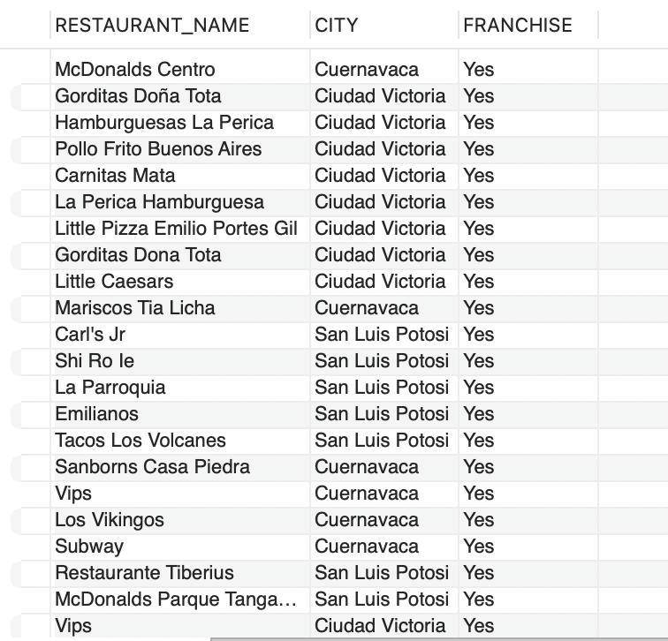

4.Find the names and cities of all restaurants that are part of a 'Franchise'.

Slide 12
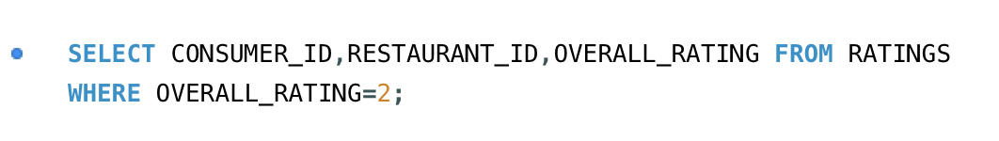
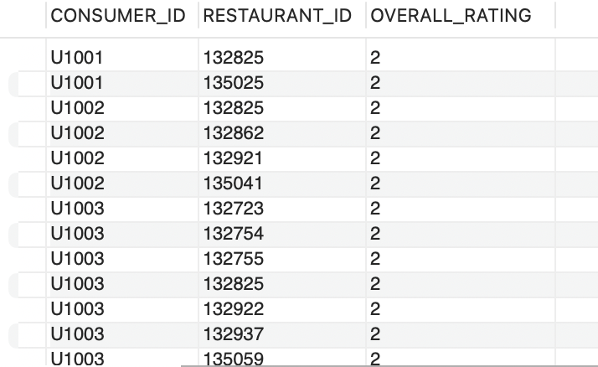
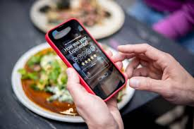
5.Show the Consumer ID, Restaurant ID, and Overall Rating for all ratings where the Overall Rating was 'Highly Satisfactory' (which corresponds to a value of 2, according to the data dictionary).

Slide 13
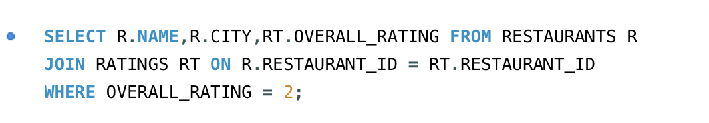
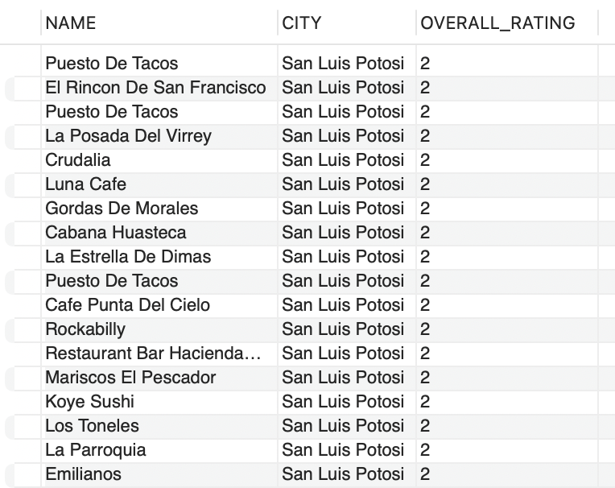

6.List the names and cities of all restaurants that have an Overall Rating of 2 (Highly Satisfactory) from at least one consumer.

Slide 14
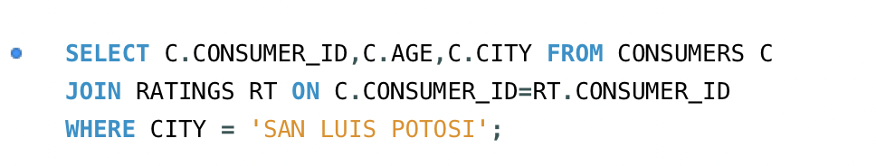
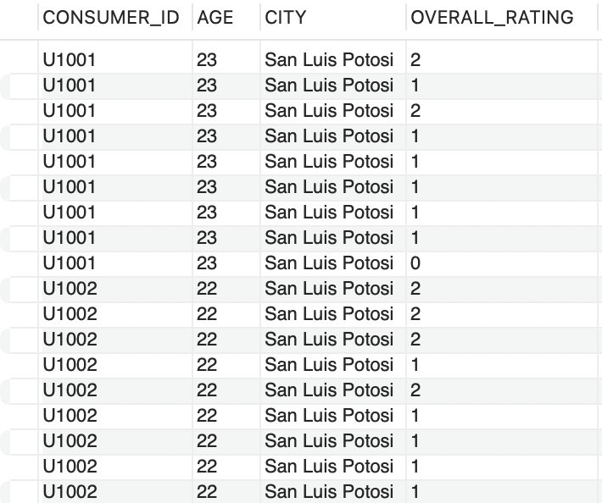
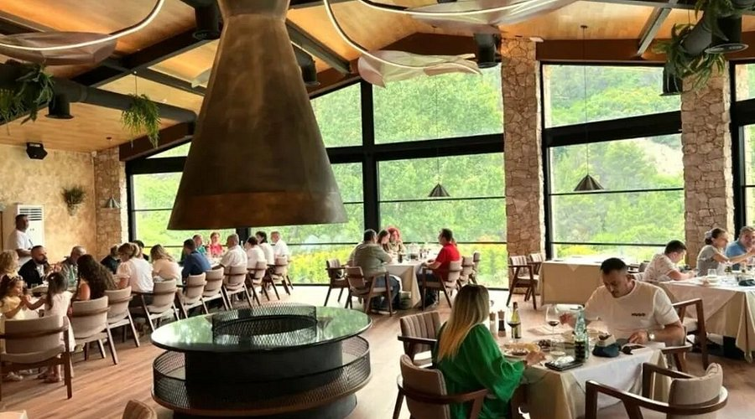
7.Find the Consumer ID and Age of consumers who have rated restaurants located in 'San Luis Potosi'.

Slide 15
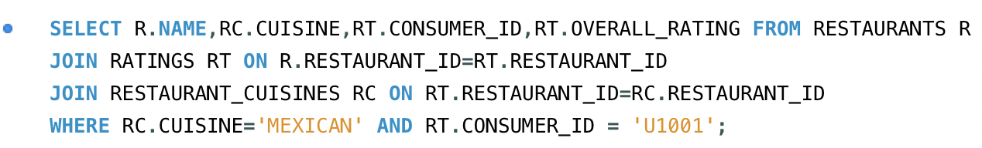
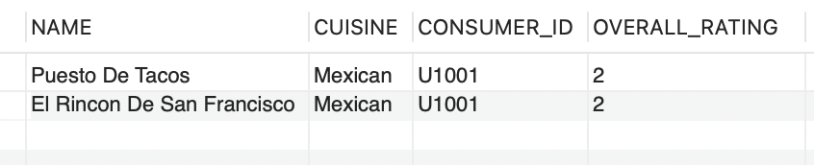
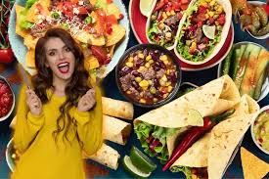
8.List the names of restaurants that serve 'Mexican' cuisine and have been rated by consumer 'U1001'.

Slide 16
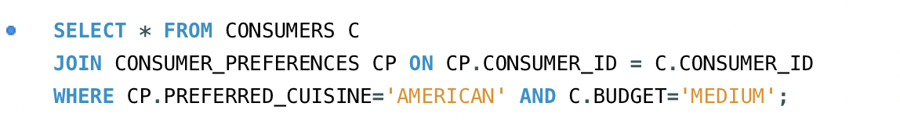
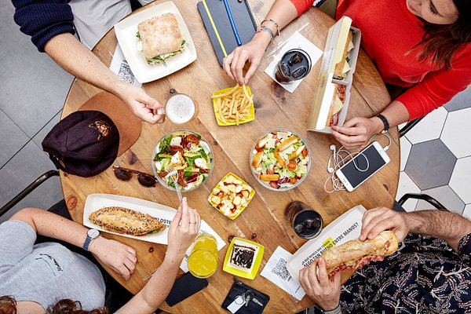
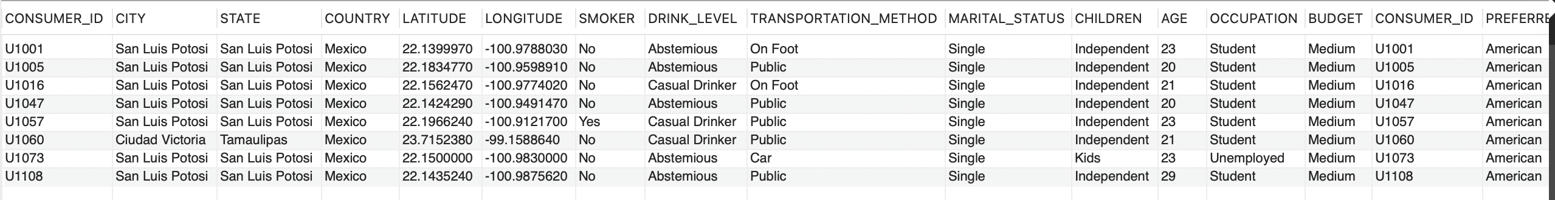
9.Find all details of consumers who prefer 'American' cuisine and have a 'Medium' budget.

Slide 17

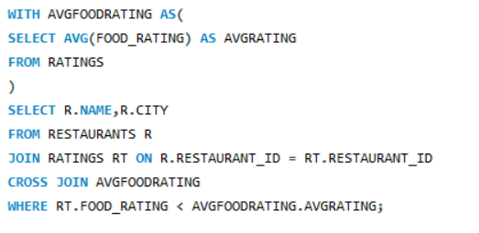
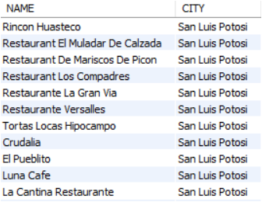
10.List restaurants (Name, City) that have received a Food Rating lower than the average Food Rating across all rated restaurants.

Slide 18
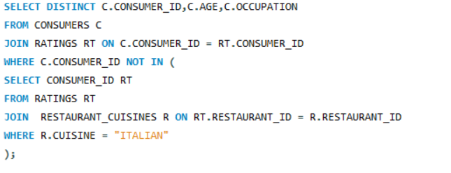
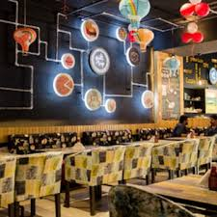
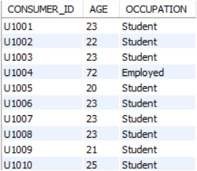
11.Find consumers (Consumer ID, Age, Occupation) who have rated at least one restaurant but have NOT rated any restaurant that serves 'Italian' cuisine.

Slide 19
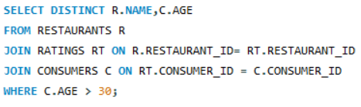
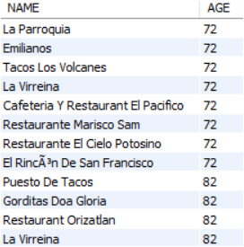

12.List restaurants (Name) that have received ratings from consumers older than 30.

Slide 20
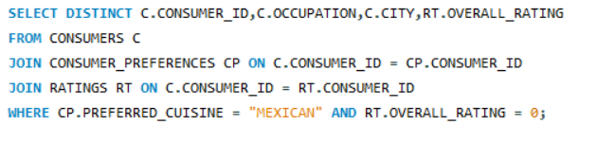
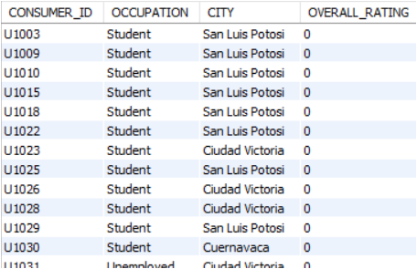
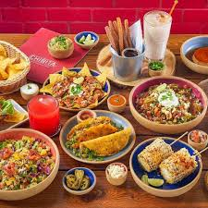
13.Find the Consumer ID and Occupation of consumers whose preferred cuisine is 'Mexican' and who have given an Overall Rating of 0 to at least one restaurant .
Rating 0

Slide 21
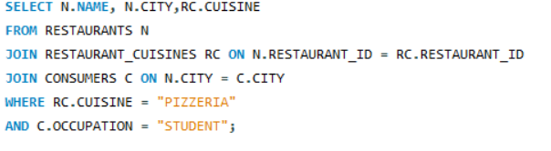
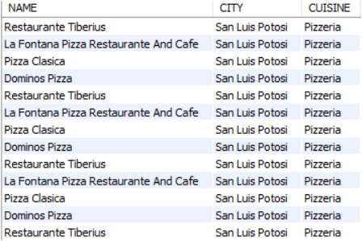
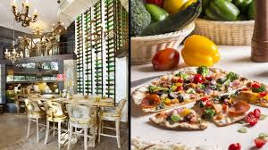
14.List the names and cities of restaurants that serve 'Pizzeria' cuisine and are located in a city where at least one 'Student' consumer lives.

Slide 22
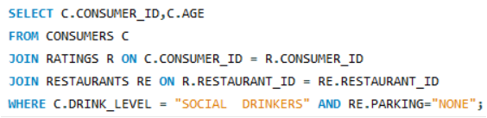

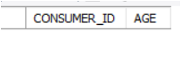
15.Find consumers (Consumer ID, Age) who are 'Social Drinkers' and have rated a restaurant that has 'No' parking.

Slide 23
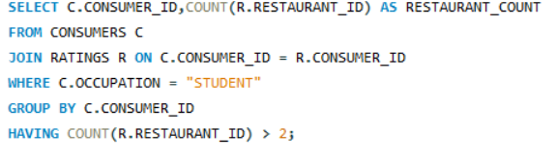

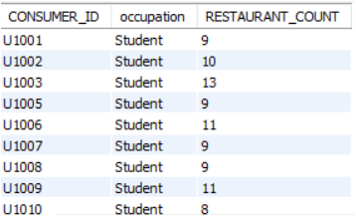
16. List Consumer_IDs and the count of restaurants they've rated, but only for consumers who are 'Students'. Show only students who have rated more than 2 restaurants.

Slide 24
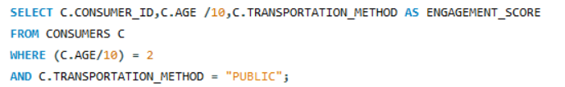
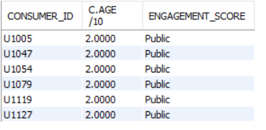
17. List the Consumer ID, Age, and this calculated Engagement Score, but only for consumers whose Engagement Score would be exactly 2 and who use ‘Public-transporation’.

Slide 25
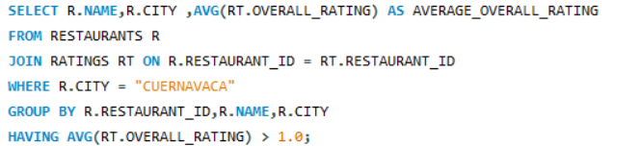
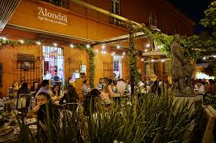
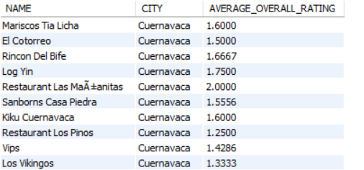
18. list the restaurant Name, City, and its calculated average Overall Rating, but only for restaurants located in 'Cuernavaca’ and whose calculated average Overall Rating is greater than 1.0.

Slide 26
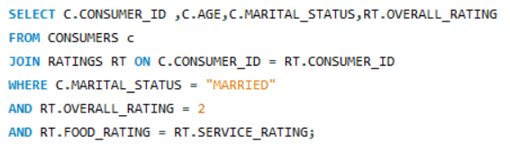


19.Find consumers (Consumer ID, Age) who are 'Married' and whose Food Rating for any restaurant is equal to their Service Rating for that same restaurant, but only consider ratings where the Overall Rating was 2.

Slide 27



20 .List Consumer ID, Age, and the Name of any restaurant they rated, but only for consumers who are 'Employed' and have given a Food Rating of 0 to at least one restaurant located in 'Ciudad Victoria'.

Slide 28


21.Using a CTE, find all consumers who live in 'San Luis Potosi'. Then, list their Consumer ID, Age, and the Name of any Mexican restaurant they have rated with an Overall Rating of 2.

Slide 29



22.For each Occupation, find the average age of consumers. Only consider consumers who have made at least one rating.

Slide 30


23 .To get all ratings for restaurants in 'Cuernavaca', rank these ratings within each restaurant based on Overall Rating . Display Restaurant ID, Consumer ID, Overall Rating, and the Rating Rank.

Slide 31



24.For each rating, show the Consumer_ID, Restaurant_ID, Overall_Rating and display the average Overall_Rating given by that specific consumer across all their ratings.

Slide 32


25.Identify students who have a 'Low' budget. Then, for each of these students, list their top 3 most preferred cuisines based on the order they appear in the Consumer Preferences table.

Slide 33


26.Consider all ratings made by 'Consumer ID' = 'U1008'. For each rating, show the Restaurant ID, Overall Rating, and the Overall Rating of the next restaurant they rated, ordered by Restaurant ID

Slide 34



27.Create a VIEW named Highly Rated Mexican Restaurants that shows the Restaurant ID, Name, and City of all Mexican restaurants that have an average Overall Rating greater than 1.5.

Slide 35



28 .Find consumers who prefer 'Mexican' cuisine, list those consumers (Consumer ID) who have not rated any restaurant listed in the Highly Rated Mexican Restaurants view.

Slide 36


29.Create a stored procedure Get Restaurant Ratings Above Threshold that accepts a Restaurant ID and a minimum Overall Rating as input. It should return the Consumer ID, Overall Rating, Food Rating, and Service Rating for that restaurant where the Overall Rating meets or exceeds the threshold.

Slide 37
CONCLUSION

Slide 38


